Slide 1
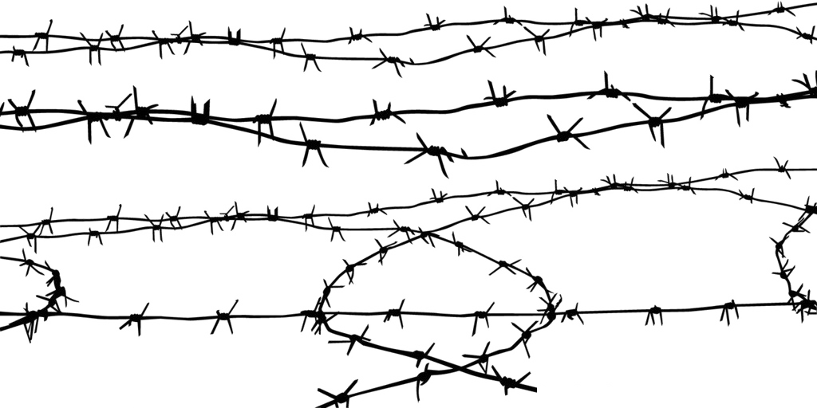
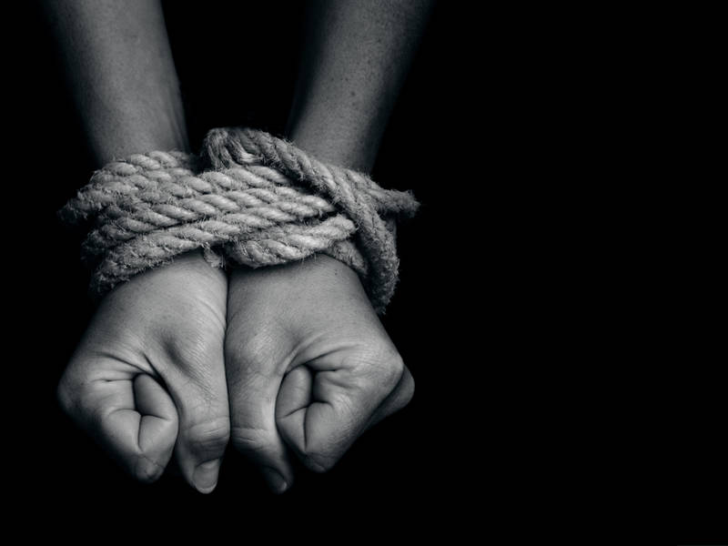
Modern Slavery
Complain.app
4* Hack’n’Lead - 2019
Kate, Albin, Ashley, Masha

Slide 2



It can be hard to understand that things are going wrong
What bothered you today?
…|
Your location
Complain

Slide 3


Analyze and suggest
Take it easy, hard days happen
You could consult your psychologist
What bothered you today?
…|
Your location
Complain
Forward to NGO
Please contact <location> hotline:
Similar cases were successfully solved
show
+() ………….

Slide 4
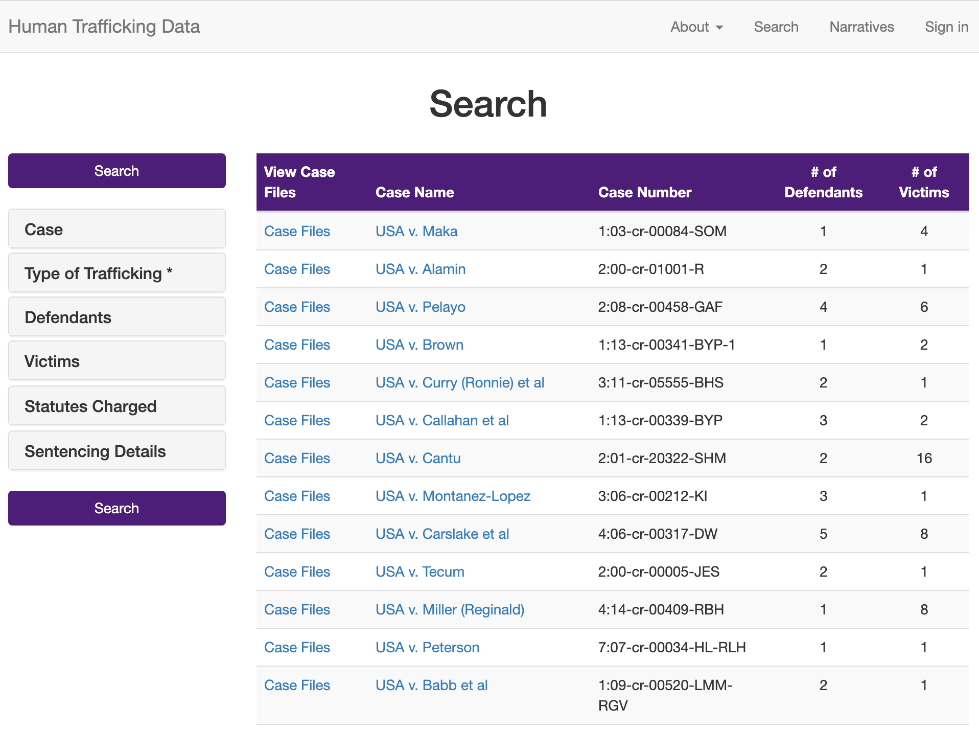
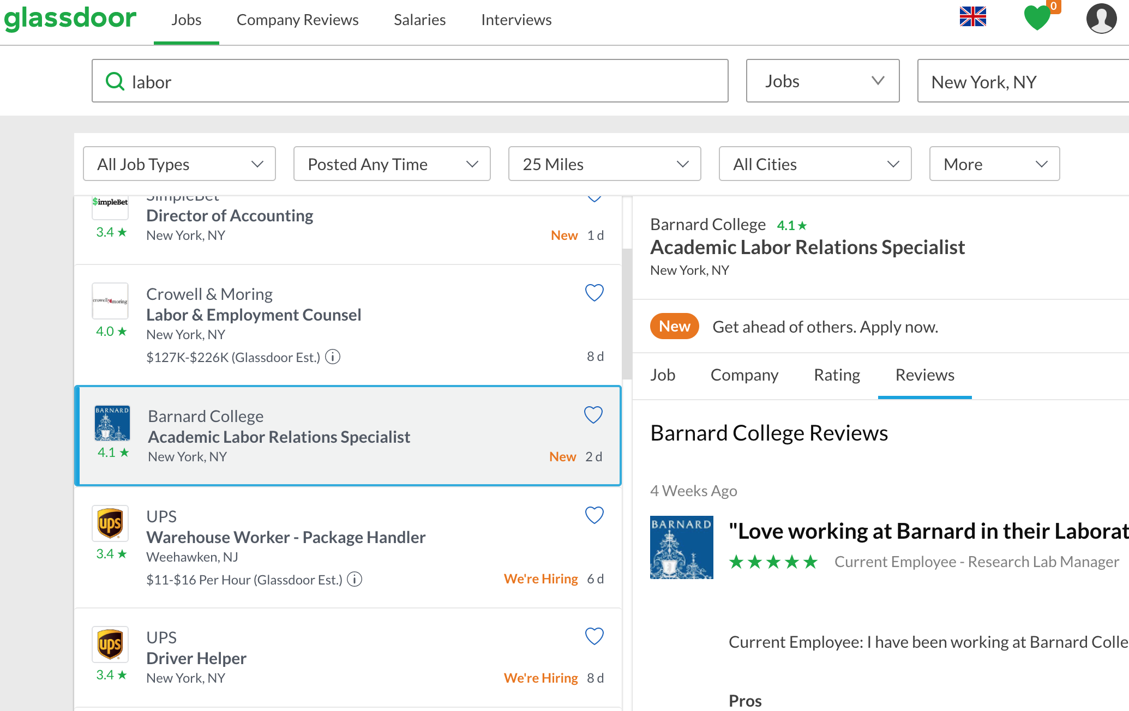
NLP models: Data
Slavery cases
+
General complains
+ Google real stories

Slide 5
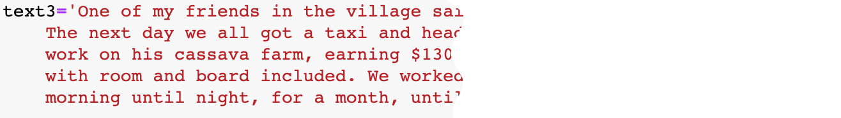
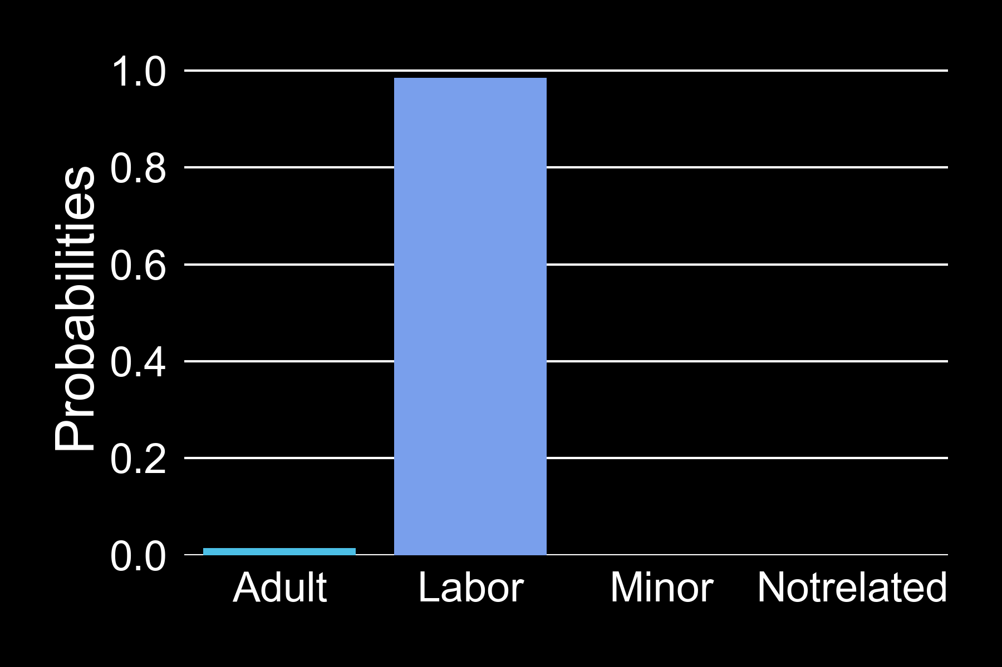

NLP models: Analysis
Doc2vec
TF-IDF
Notes:
Doc2vec is an unsupervised algorithm to generate vectors for sentence/paragraphs/documents.
Doc2vec: unsupervised -> generate vectors for sentence/paragraphs/documents.
tf–idf: numerical statistic -> reflect importance of a word to a document in a collection of document
or just collection

Slide 6
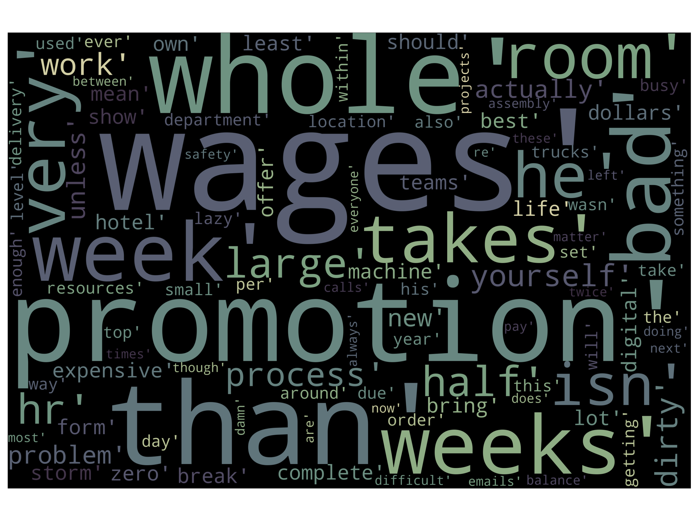
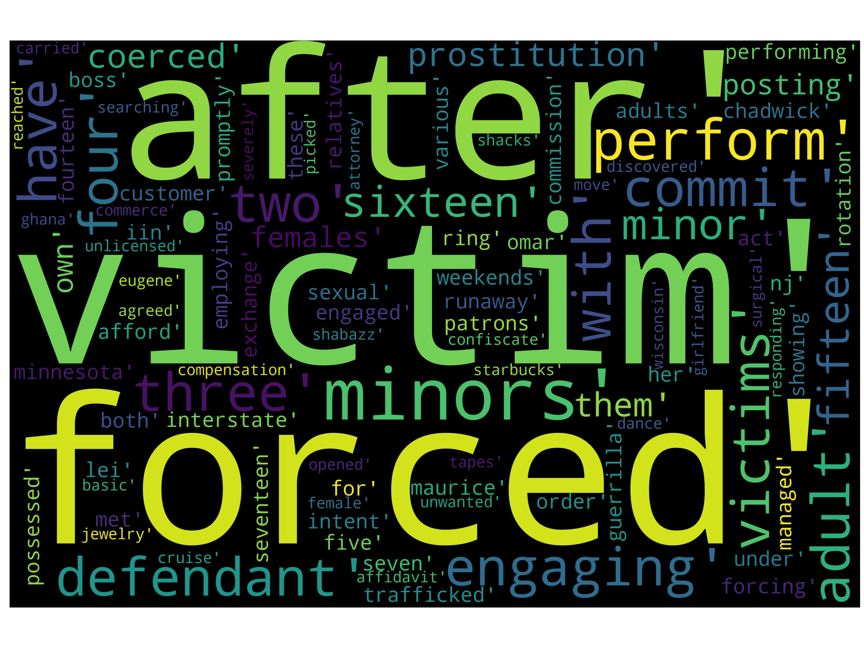
NLP models: Result
Everyday complains
Slave complains

Slide 7
NLP models: Result
Data improvement:
Use real human complains
Change complain time from past to present
Extend to different countries
More features for the App:
Pre-install the App in the countries with high slavery rate
Check job-ads
Off-line functionality
Deploy it as filter for incoming calls to hotlines

